Slide 1
19Z701 - CRYPTOGRAPHY

Slide 2
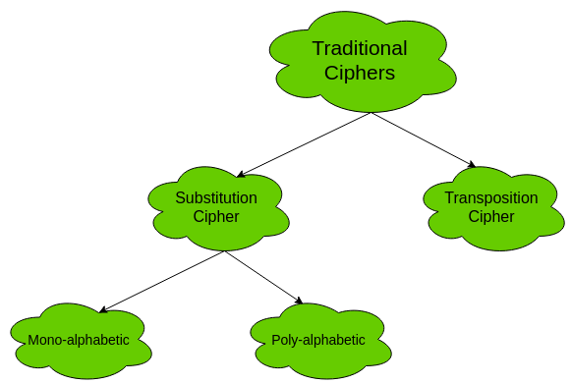
Traditional Symmetric Ciphers
The two types of traditional symmetric ciphers are Substitution Cipher and Transposition Cipher.
The following flowchart categories the traditional ciphers:

Slide 3
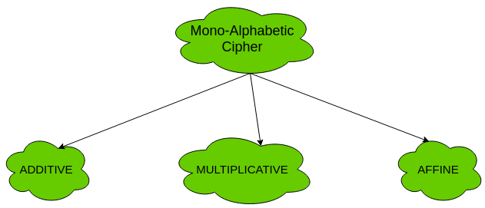
Types of mono-alphabetic ciphers are:

Slide 4
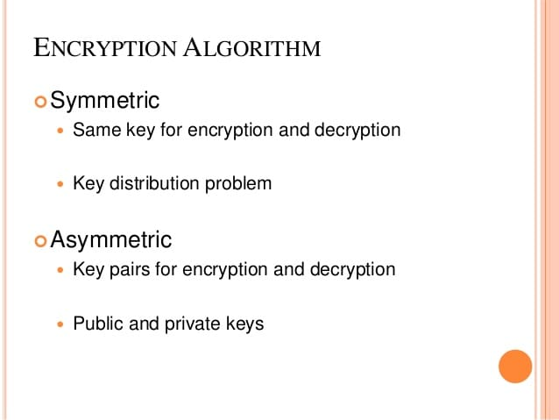

Slide 5
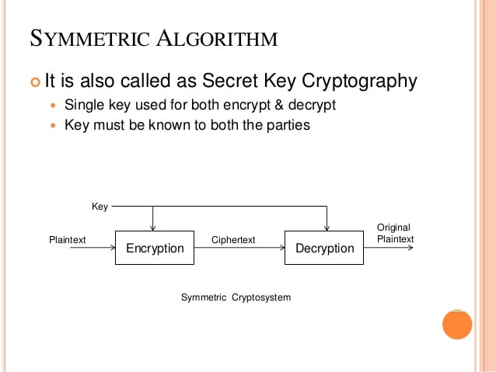

Slide 6
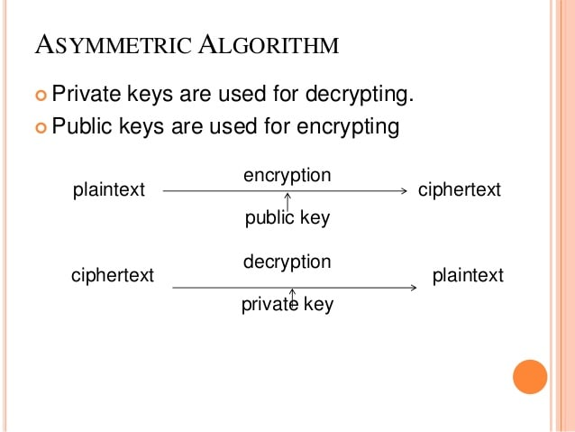

Slide 7
Classical Substitution Ciphers
where letters of plaintext are replaced by other letters or by numbers or symbols
or if plaintext is viewed as a sequence of bits, then substitution involves replacing plaintext bit patterns with ciphertext bit patterns

Slide 8
Caesar Cipher
earliest known substitution cipher
by Julius Caesar
first attested use in military affairs
replaces each letter by 3rd letter on
example:
  meet me after the toga party
  PHHW PH DIWHU WKH WRJD SDUWB

Slide 9
Caesar Cipher
can define transformation as:
  a b c d e f g h i j k l m n o p q r s t u v w x y z
  D E F G H I J K L M N O P Q R S T U V W X Y Z A B C
mathematically give each letter a number
  a b c d e f g h i j k l m n o p q r s t u v w x y z
  0 1 2 3 4 5 6 7 8 9 10 11 12 13 14 15 16 17 18 19 20 21 22 23 24 25
then have Caesar cipher as:
  c = E(p) = (p + k) mod (26)
  p = D(c) = (c – k) mod (26)

Slide 10
Cryptanalysis of Caesar Cipher
only have 26 possible ciphers
  A maps to A,B,..Z
could simply try each in turn
a brute force search
given ciphertext, just try all shifts of letters
do need to recognize when have plaintext
eg. break ciphertext "GCUA VQ DTGCM"

Slide 11
Example Cryptanalysis
given ciphertext:
  UZQSOVUOHXMOPVGPOZPEVSGZWSZOPFPESXUDBMETSXAIZ
  VUEPHZHMDZSHZOWSFPAPPDTSVPQUZWYMXUZUHSX
  EPYEPOPDZSZUFPOMBZWPFUPZHMDJUDTMOHMQ
count relative letter frequencies (see text)
guess P & Z are e and t
guess ZW is th and hence ZWP is the
proceeding with trial and error finally get:
  it was disclosed yesterday that several informal but
  direct contacts have been made with political
  representatives of the viet cong in moscow

Slide 12
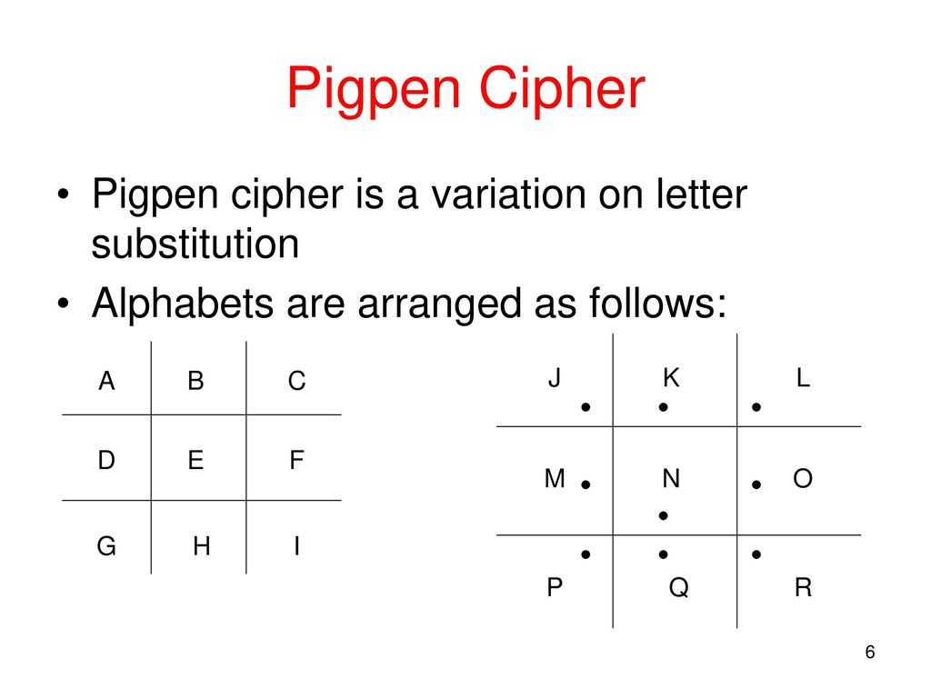

Slide 13
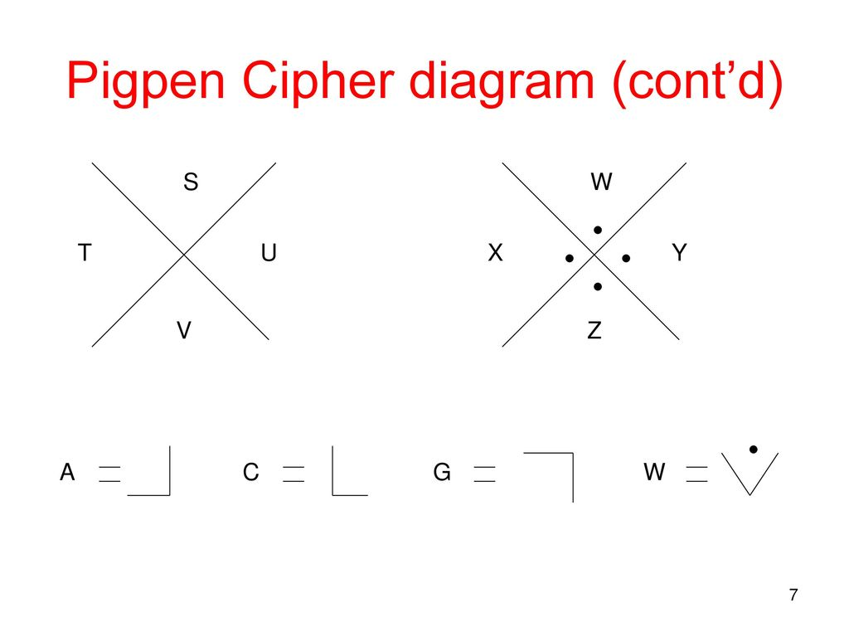

Slide 14
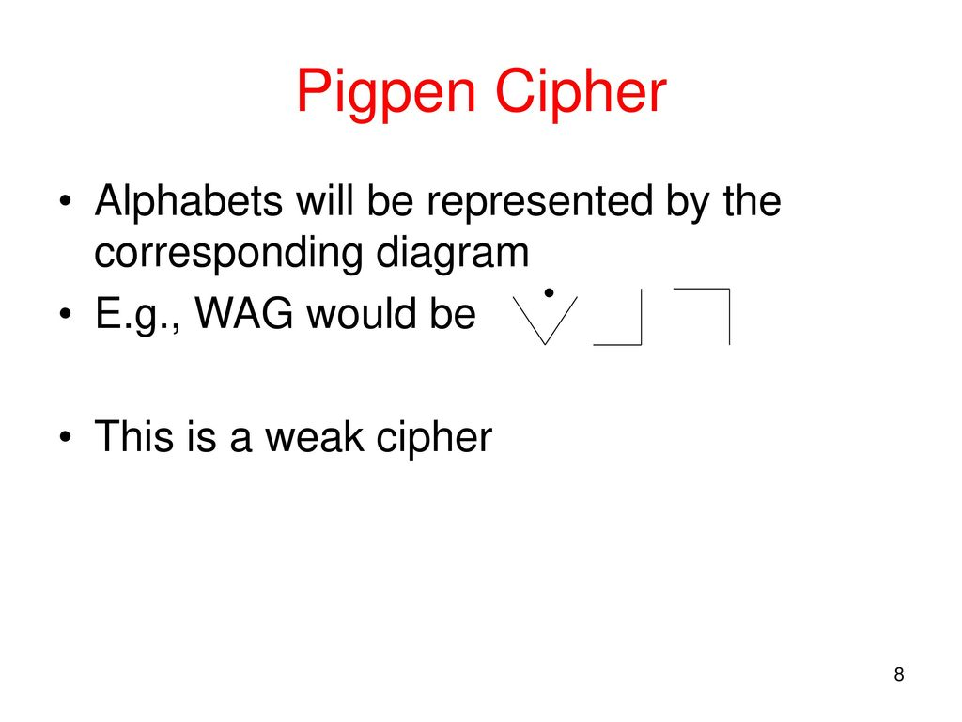

Slide 15
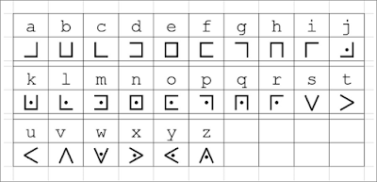

Slide 16

Decode the following pigpen ciphertext:
Encode the following message using the pigpen cipher:
the truth is out there

Slide 17
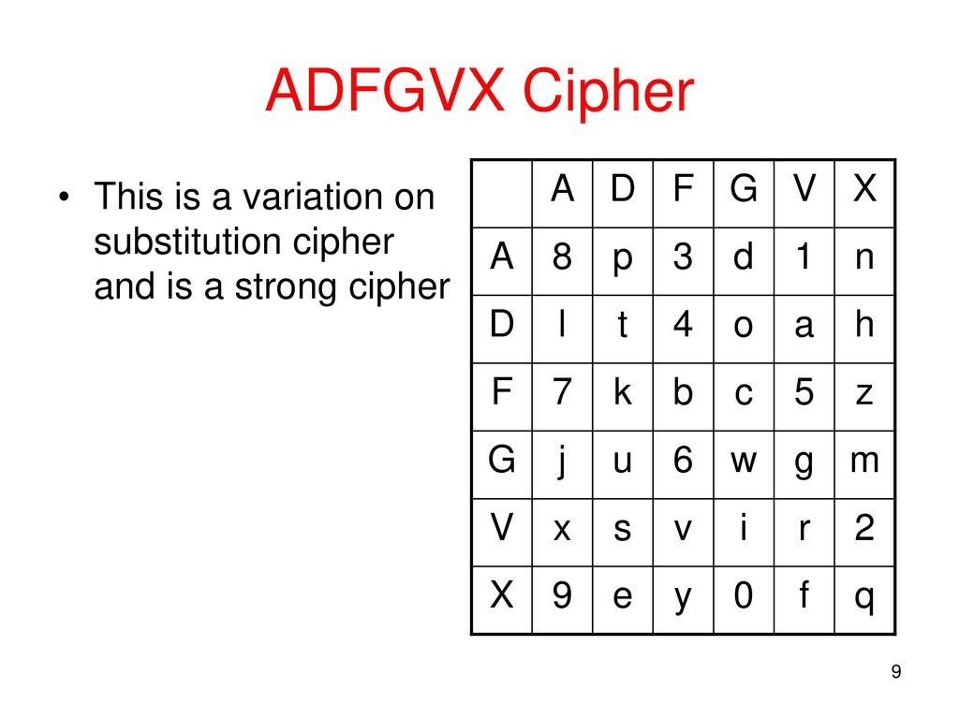

Slide 18
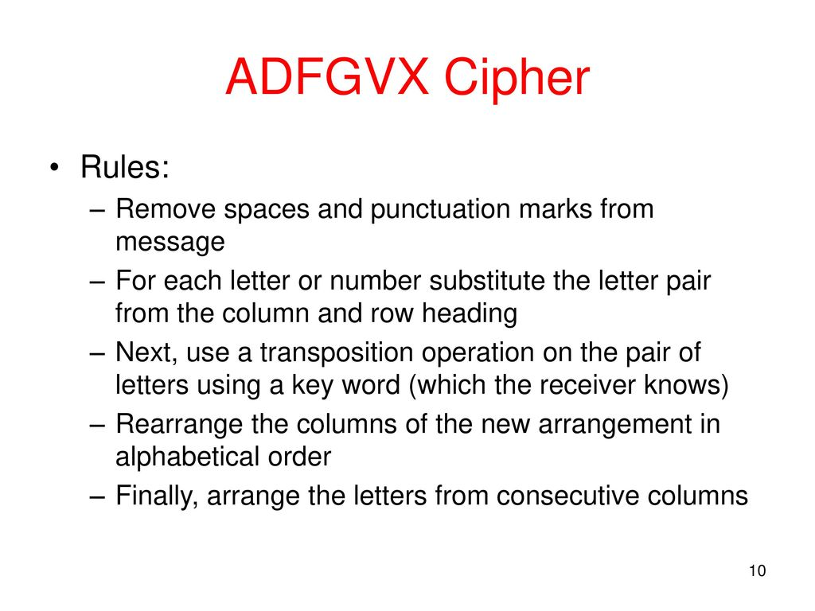

Slide 19
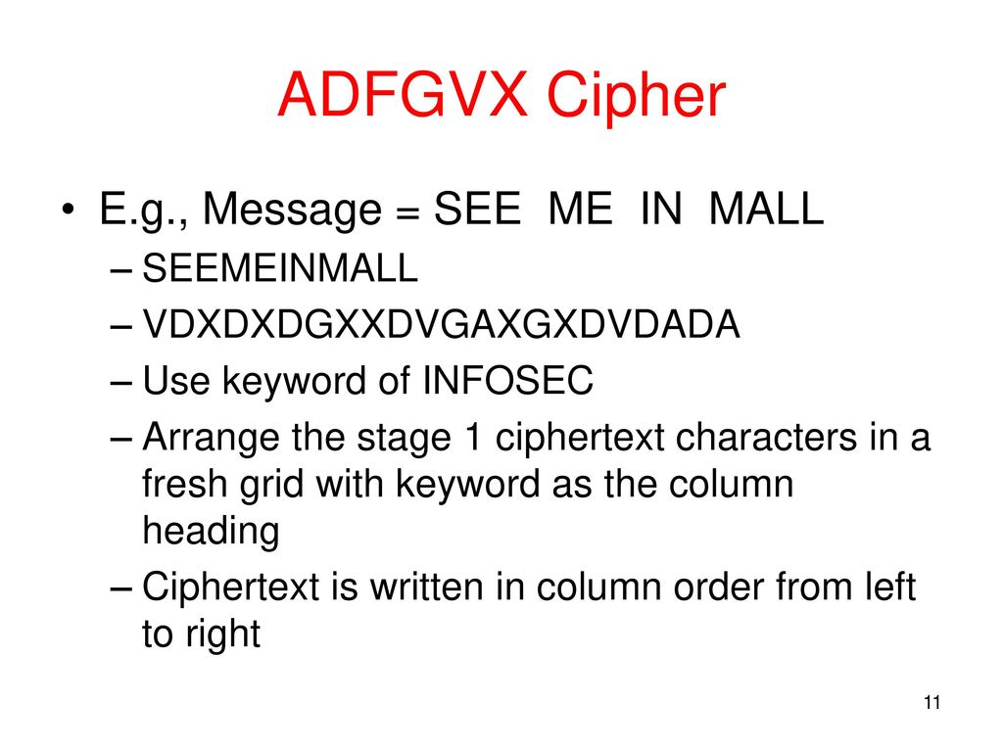

Slide 20
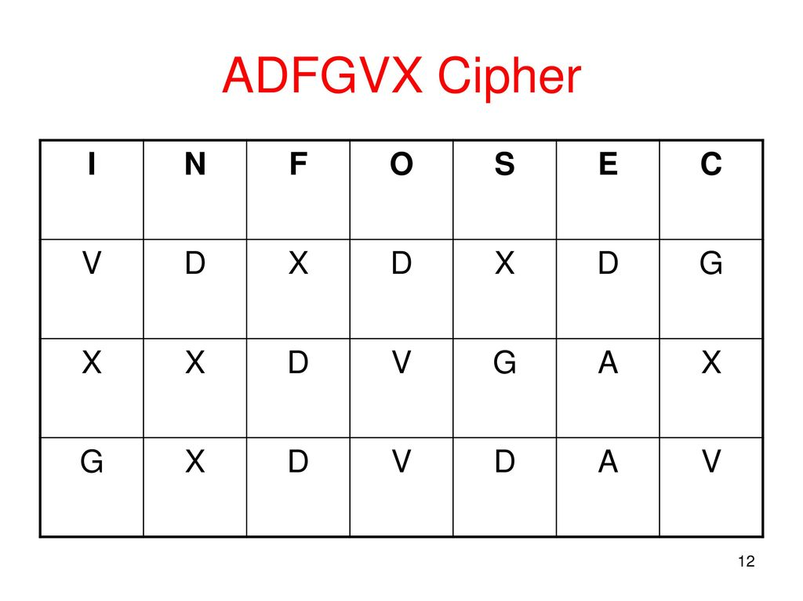

Slide 21
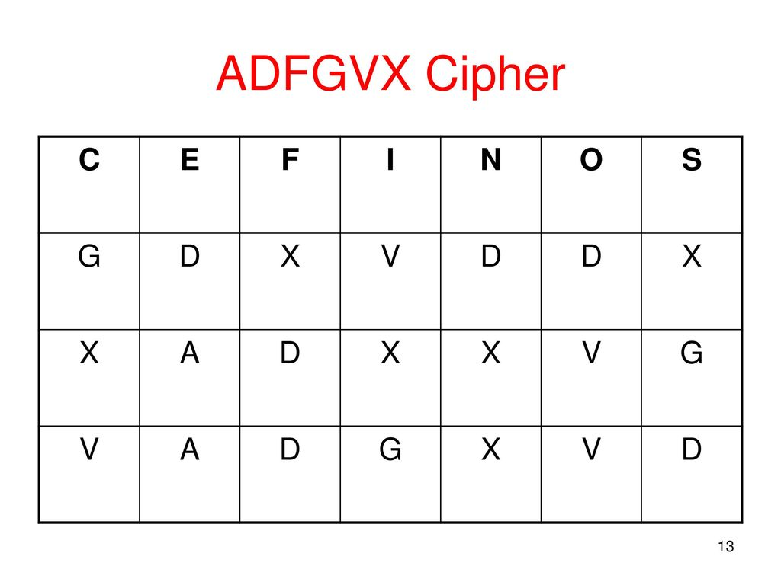

Slide 22
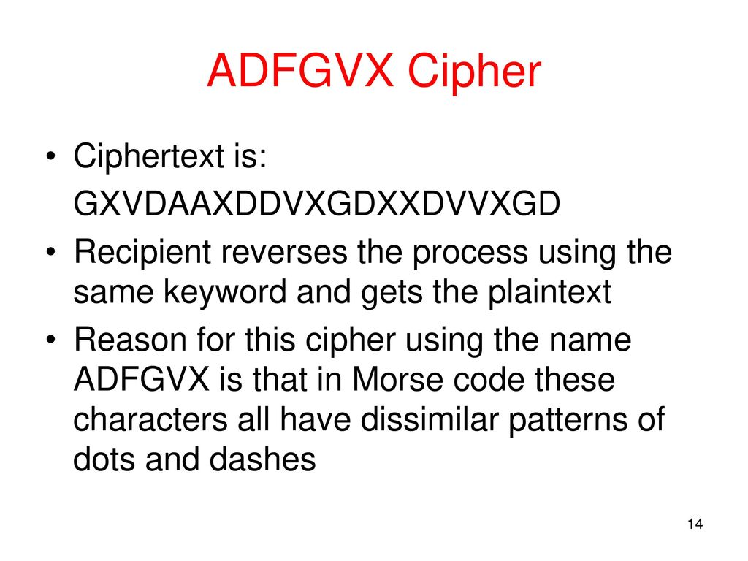

Slide 23
Multiplicative Cipher
The multiplicative cipher is similar to additive cipher except the fact that the key bit is multiplied to the plain-text symbol during encryption. Likewise, the cipher-text is multiplied by the multiplicative inverse of key for decryption to obtain back the plain-text.
C = (M * k) mod n
M = (C * k⁻¹) mod n
where,
k⁻¹ -> multiplicative inverse of k (key)
The key space of multiplicative cipher is 12. Thus, it is also not very secure.

Slide 24
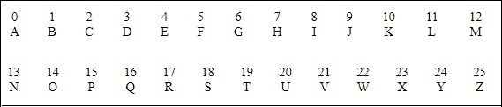
Multiplicative Cipher
If multiplication is used to convert to cipher text, it is called a wrap-around situation. Consider the letters and the
associated numbers to be used as shown below −
The numbers will be used for multiplication procedure and the associated key is 7. The basic formula to be used in such a scenario to generate a multiplicative cipher is as follows −
(Alphabet Number * key)mod(total number of alphabets)

Slide 25
